Slide 1
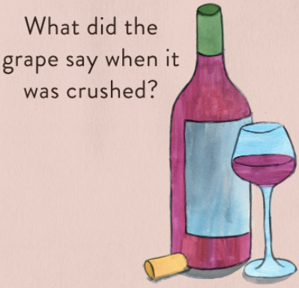
From Data Scientist to Sommelier
Brandie Parker, Jong Kim,
Junki Ogawa, Charlotte Coolidge
Notes:
Charlotte- Chardon-hey, everyone!
So, what did the grape say when it was crushed?
“Nothing, it just let out a little wine”
Our wine club, I mean… team consists of Brandie, Jong, Junki and myself!
Our first iteration idea was to do a ML Wordle project, but we quickly found that idea was going to take far longer to flush out than we had anticipated, so we switched to our other favourite hobby - drinking!

Slide 2
Table of contents
Background
Goal/Scope
What factors can determine quality?
Process and data processing
Machine Learning Models used
Random Forest Classifier
Data Architecture
Site/Tool Demonstration - Walkthrough
Findings and Opportunities
Resources
Questions?
Notes:
Charlotte
We’ll run through the background, our data processing, our findings, and we’ll do a quick demo of our site for you all!

Slide 3
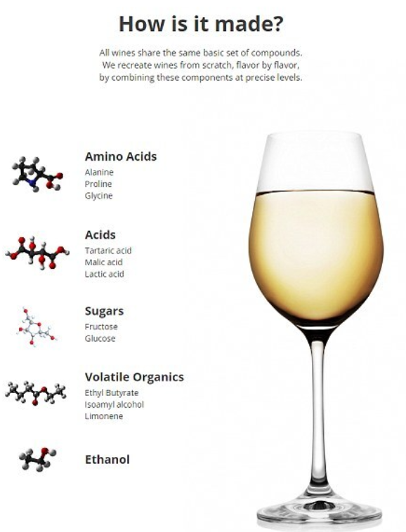
Background
What’s our ML model going to tell us about wine’s chemical compounds correlated to actual quality?
Our team found out that our trusty Madison is a bit of wine connoisseur herself, so we decided to investigate!
Notes:
Charlotte
“Show of hands - Who all enjoys a good wine? ”

Slide 4
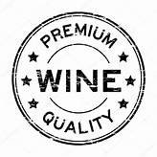
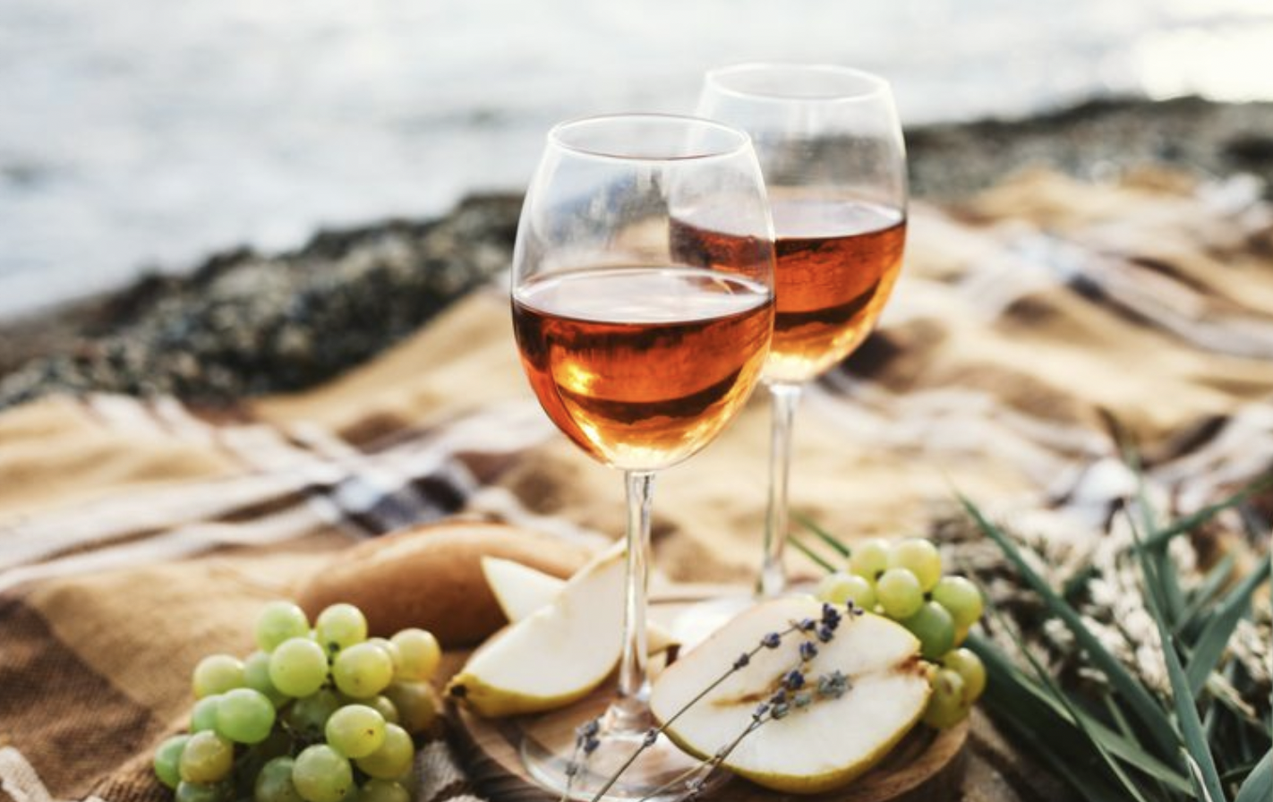
Goal/Scope
Find model that provides the best score and most accurately categorizes the wines based on their chemical data into a wine rating
Use the model to predict how a wine will rate based on its chemical properties (alcohol content, residual sugar, acidity, etc)
Notes:
Charlotte - Transition to Brandie
We set out to find a ML model which provides the most accurate score, and categorizes our wines based on chemical data, and then turn those results into an overall wine rating. Which is 1-10.
So, when we go through our demo later, we’ll use our model to predict how a wine will rate, based on the inputs someone will give us!

Slide 5
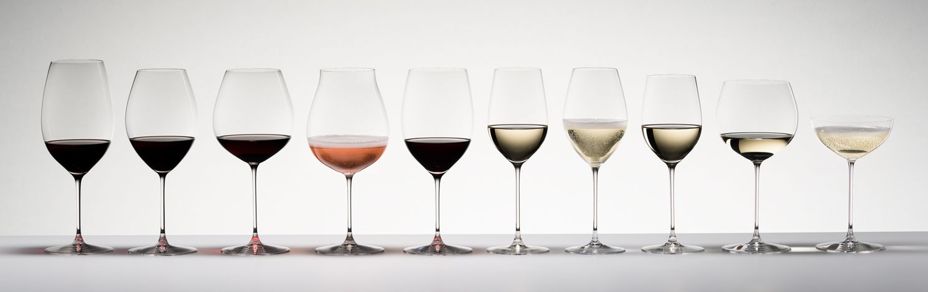
What factors can determine quality?
Acids
add to the taste, scent, and freshness of wine
Chlorides
too much can result in salty or flat wine
Alcohol
ideal alcohol content is 13.5%+
Sulfur Dioxide
helps to stabilize wine to stand the “test of time”
Notes:
Brandie

Slide 6
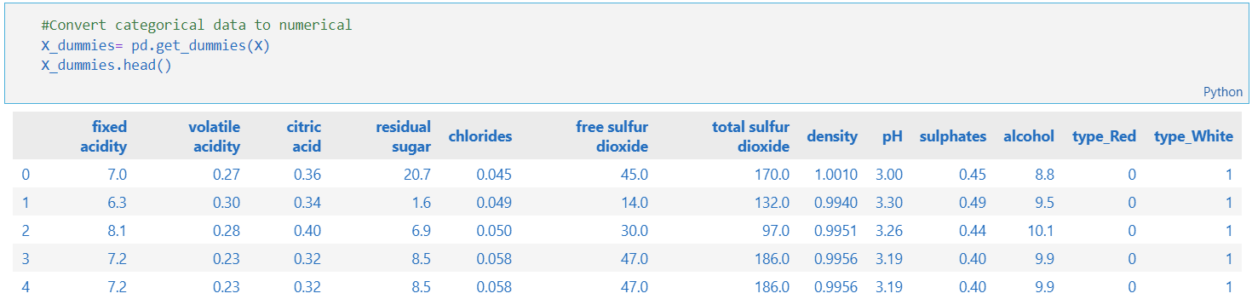
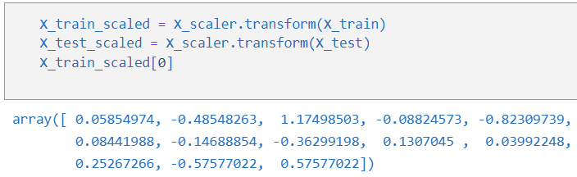
Process
Data Processing:
Research: Kaggle dataset
Preprocess the dataset
get_dummies
standardScaler
ML we’re using
Supervised:
Logistic Regression
Random Forest Classifier
Plot the model scores to see how they compare
Data Scaling:
Notes:
Brandie
Mention that we tried unsup and deep learning models as well

Slide 7
Machine Learning Models used
Model: Random Forest Classifier
Training Score: 1.0
Testing Score: 0.692923
Model: Logistic Regression
Training Data Score: 0.538998
Testing Data Score: 0.542769
Model: Lasso
Train score: 0.0
Test Score: -0.000654
Model: LinearRegression
Train score: 0.002049
Test Score: -0.002469
Model: KNeighborsRegressor
Train score: 0.189193
Test Score: -0.217372
Model: RandomForestRegressor
Train score: 0.735172
Test Score: -0.155091
Model: ExtraTreesRegressor
Train score: 0.846294
Test Score: -0.306193
Model: AdaBoostRegressor
Train score: 0.012325
Test Score: -0.003602
Model: SVR
Train score: 0.061404
Test Score: -0.013790
Unsupervised
TSNE / K-MEANS Clustering
Deep Learning
keras/Tensorflow
Notes:
junki

Slide 8
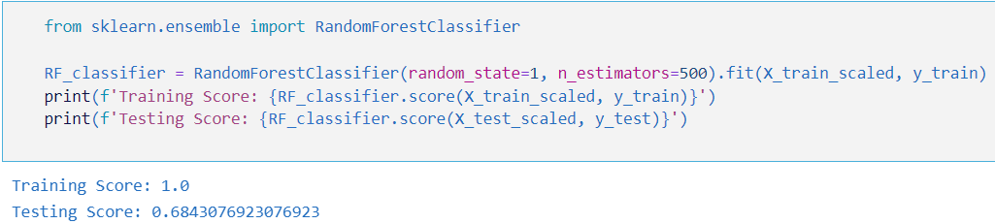
Random Forest Classifier
Why Random Forest Classifier
Help reduce features to improve scores, easy to determine feature importance
Provides flexibility for regression and classification, and reduces risk of overfitting
Notes:
Junki

Slide 9
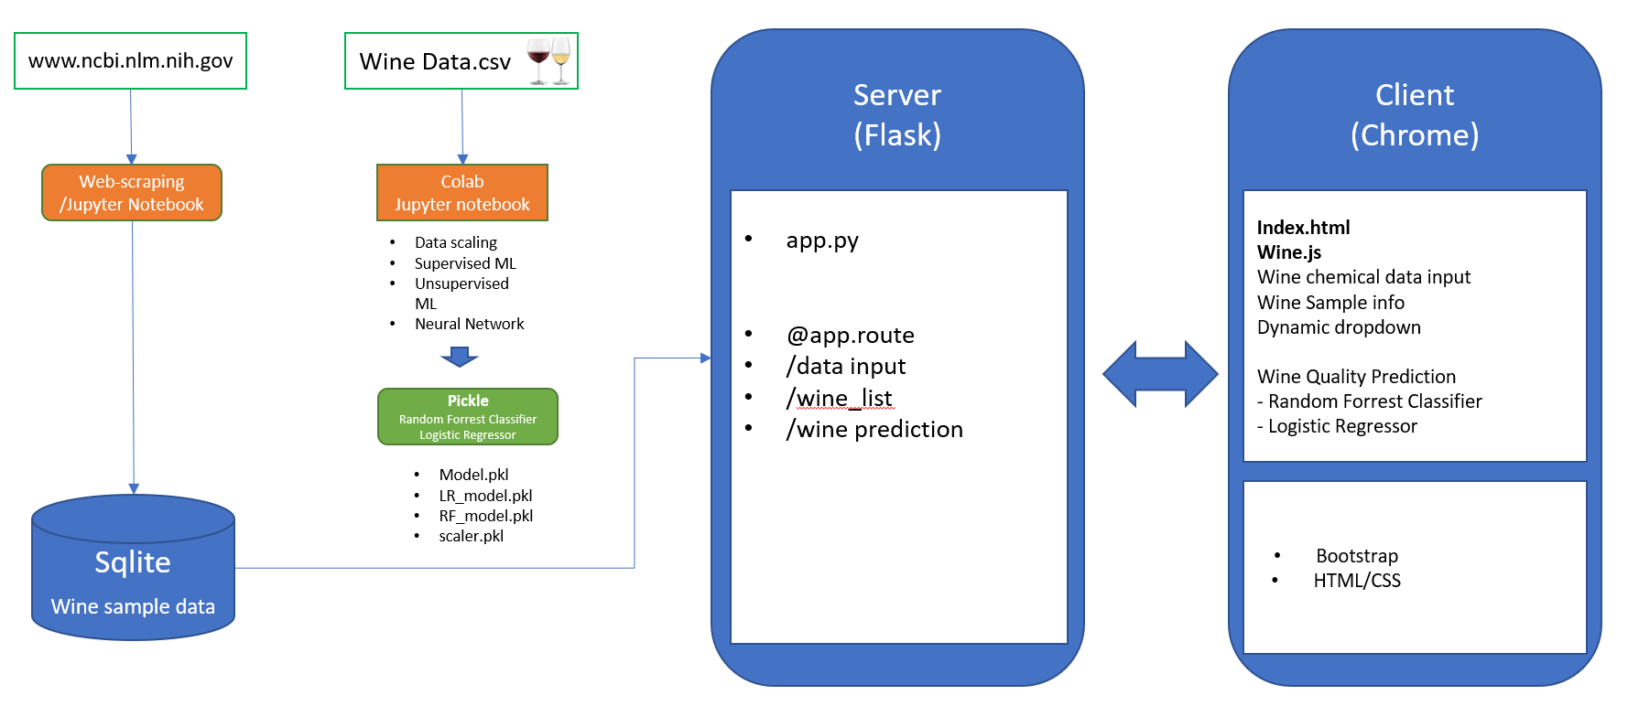
Data Architecture
Notes:
Jong -

Slide 10
Site/Tool Demonstration - Walkthrough
Notes:
Jong

Slide 11
Findings and Opportunities
Findings
Higher the alcohol, higher the quality
44% correlation between high alcohol and high quality
Lower density or lower volatile acidity, higher the quality
31% and 27% correlation to high quality
Opportunities
Find better model to beat RF’s testing score of .68
Quality is subjective - hard to determine how that plays into our modeling
Finding chemical components of wine is difficult to find
Notes:
Junki -
Time to wine down

Slide 12
Resources
https://online.stat.psu.edu/stat508/lesson/analysis-wine-quality-data
https://medium.com/@jamal.henani/red-wine-quality-947e3e3c275b
https://towardsdatascience.com/a-data-scientists-guide-to-buying-wine-b584c77b9e60
https://ai.plainenglish.io/prediction-of-a-wine-brands-quality-based-on-the-chemical-composition-of-the-products-using-c5727f8d4289
www.ncbi.nlm.nih.gov

Slide 13

Questions?

